Slide 1
Computer Science, Chapter 2: Computer Architecture
Presented by: Lilla Ball

Slide 2
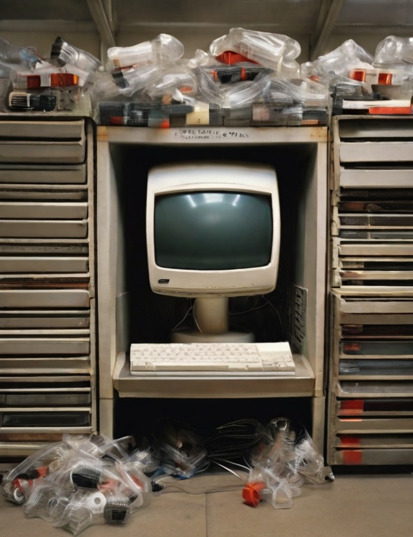
Stored Program Concept
Computer programs used to be hardwired into the computer.
Computer were “single use”: Could only do the set of instructions already programmed into the hardware.
“Stored program” concept revolutionized computer programming.
Concept is: Store the program (the set of instructions) in the computer's memory, now computers could be “programmable”
Developed at the University of Pennsylvania School of Electrical Engineering
NOTE: John von Neumann is often wrongly credited for inventing the stored program concept ( von Neumann published the idea, he didn't invent it)

Slide 3
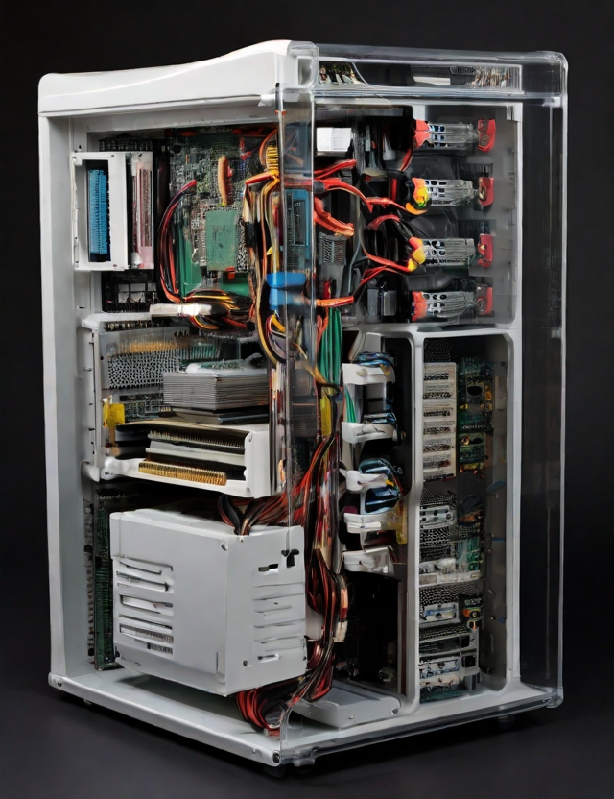
Main Components of a Computer System
Input Devices
Central Processing Unit (CPU)
Control unit: Directs the execution of the program
Arithmetic/Logic Unit: Performs arithmetic operations, Performs Boolean operations( AND,OR,XOR)
Registers( temporary memory)
Cache memory(high-speed memory in CPU)
Main memory connected to CPU via bus
-Secondary Storage
-Output devices

Slide 4
Diagram of the Computer
Central Processing Unit(CPU)
Control Unit
Arithmetic/Logic Unit
Input
Main memory
Output
Secondary memory

Slide 5
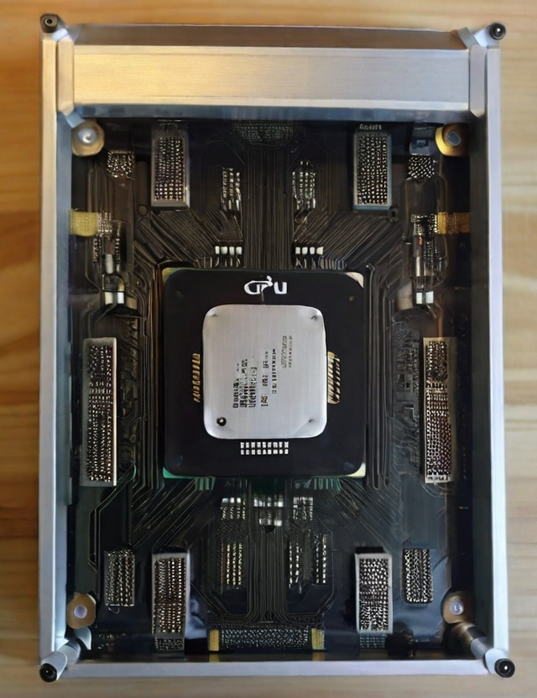
CPU Machine Language Architecture
RISC-
Reduced Instruction Set: CPUs with minimal set of instructions, designed by Apple, IBM, and Motorola
CISC-
Complex Instruction Set: Can execute a large number of complex instructions, even though many are technically redundant since manufacturing costs were greatly reduced. Now most computers, game controllers, smart TVs, ect. Use CISC.

Slide 6

Programs Versus Data
Main memory can simultaneously store both Multiple programs and Data(the information the programs operate on).
Issue: Both programs and data are binary 1s and 0s. The machine itself does not know the difference between data and a program.
Programs determine what is data and what is a program( in fact, a program can use another program as data, thereby changing the second program)

Slide 7
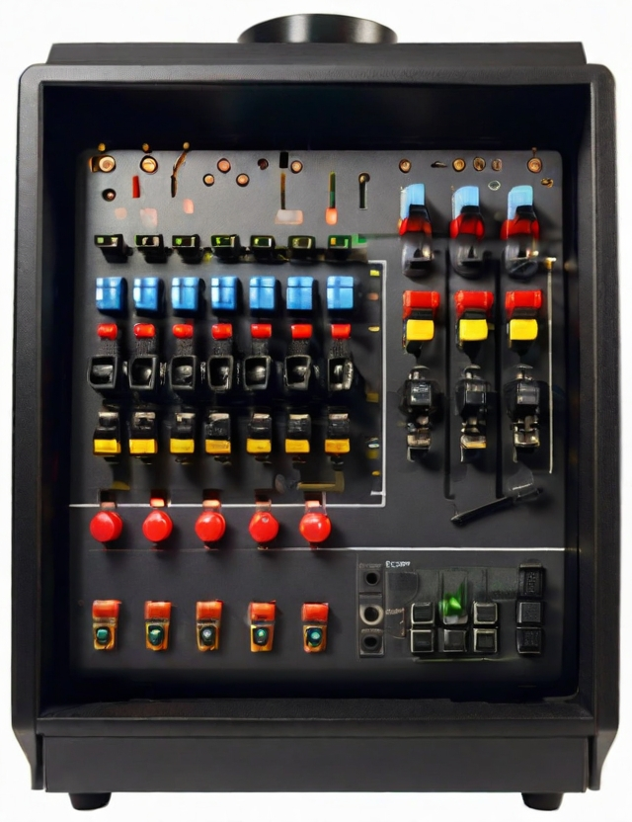

Controllers
Controllers are small, specialized CPU circuits that: Control communication between the computer and external devices. Usually there is a port (often on the back of the computer) to connect external device.
Controllers were often specialized with specific ports that only worked with certain hardware.
Communications standards allowed the development of multiple kinds of devices:
-USB( Universal Serial Bus) - DisplayPort
- HDMI(High Definition Multimedia Interface)

Slide 8
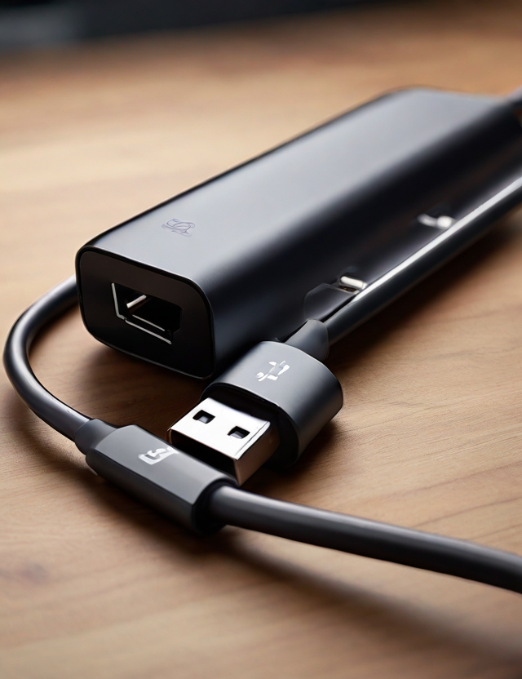
Innovation v. Standardization?
June 2022, the European Union approved directive that: All electronic devices sold in the EU be equipped with USB-C charging port. Deadline:2024.
USB-C:
-24 pin connector -Higher data transfer rates
- 100 watts - Single, universal size
- 20 volts
-Fully reversible plugs on both ends, bi-directional charging
For both small and larger devices: Cell phones, laptops, high resolution monitors, ect.

